Slide 1
Risk Assessment for Life Insurance
Data Mining – Group Project Presentation
By
Saikumar Nanjala
Sanketh Bhagavanthi
Yashwanth Lingareddy

Slide 2
Index
Problem Statement
Dataset Overview
Data Fields
Data Preparation
Evaluation Metrics
Building Model
Model Comparison
Summary
YouTube Link

Slide 3
Problem Statement
A Life Insurance company wants to make a quicker and less labor intensive for new and existing customers to get a risk assessment.
To build a predictive model that categorizes the people into different classes of risk using an automated approach.

Slide 4
Dataset Overview
Source : Kaggle
https://www.kaggle.com/c/prudential-life-insurance-assessment
Total Observations – 59381
Total Fields – 127
126 Variables
Categorical - 60
Continuous - 13
Discrete - 53
1 Target Variable – Response
Ordinal Variable

Slide 5
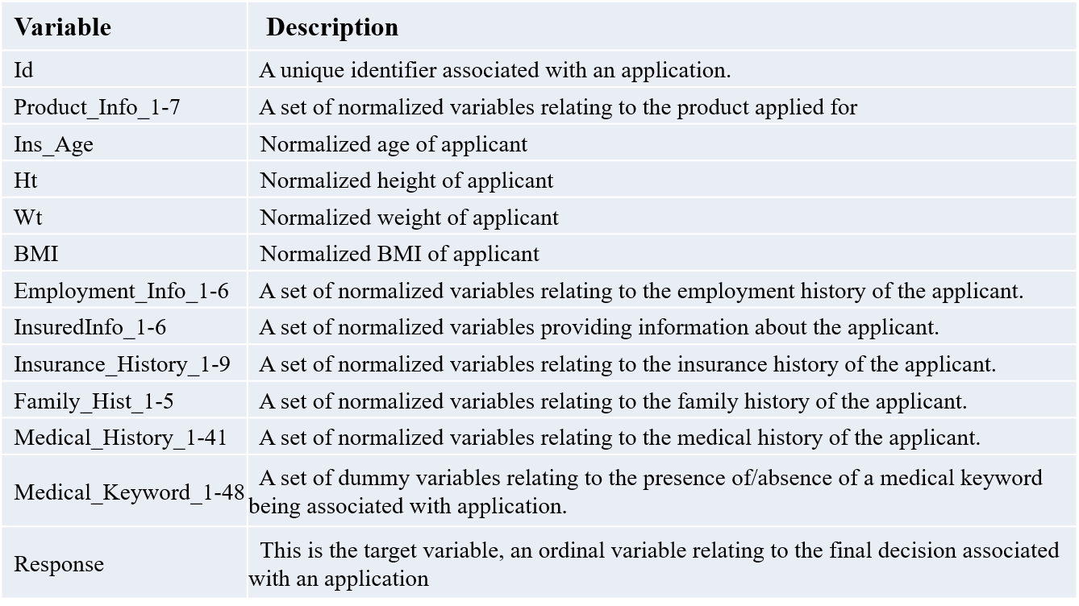
Data Fields

Slide 6
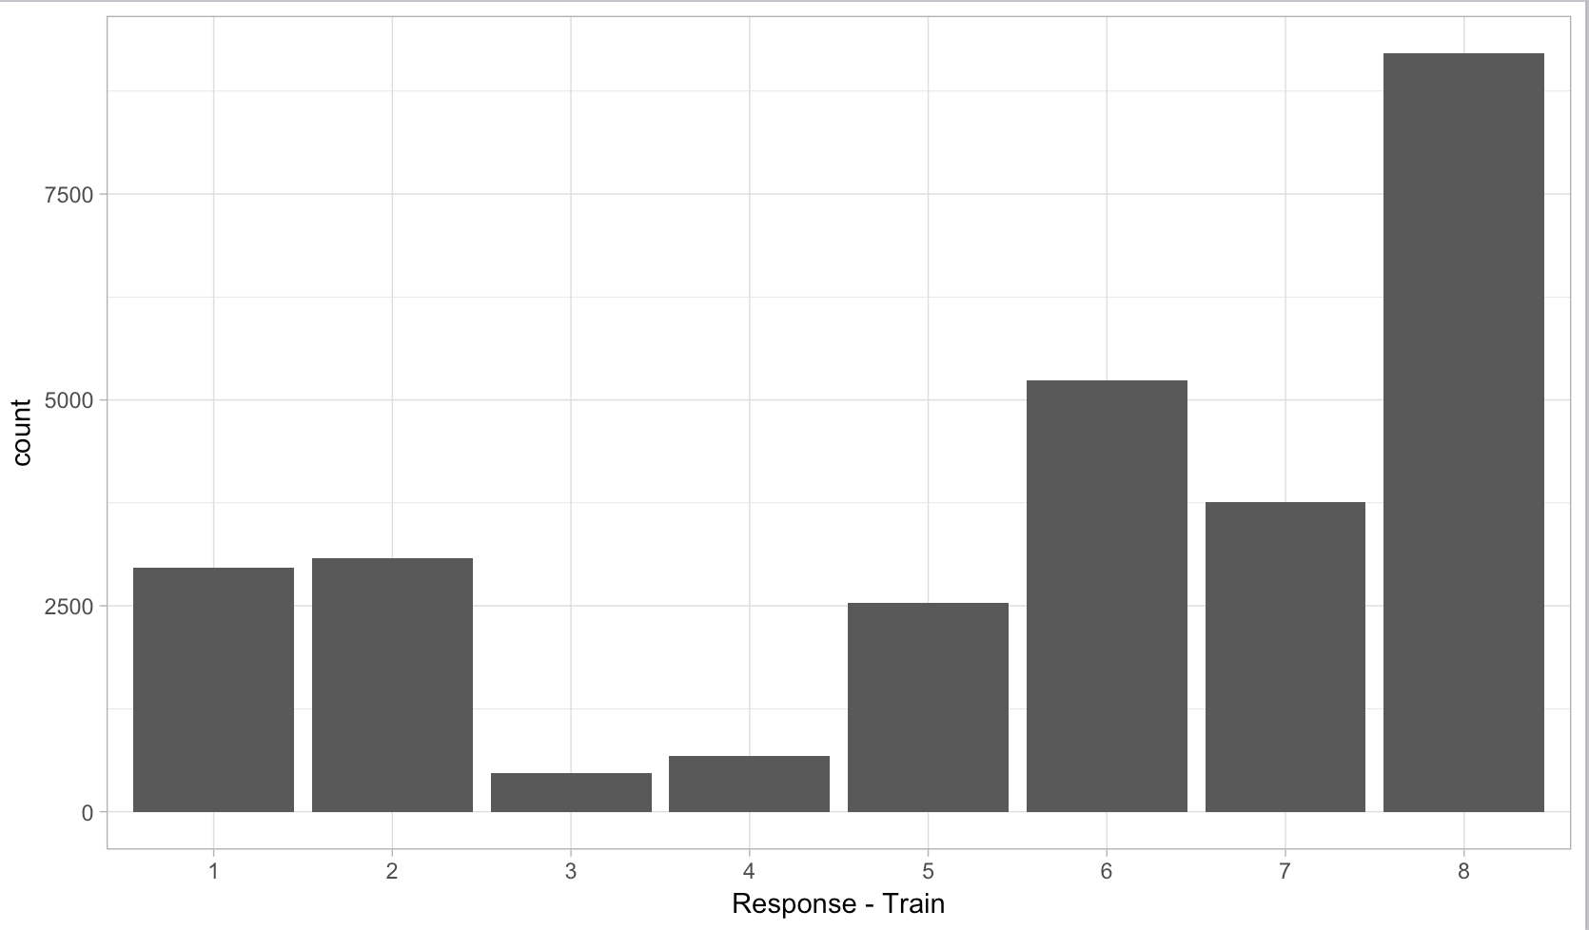
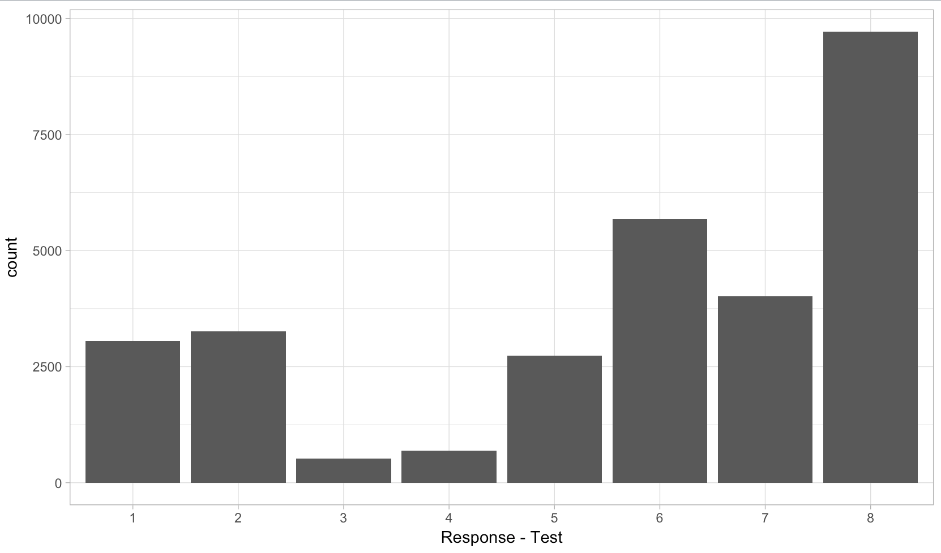
Data Preparation
Data Splitting
Random splitting the original dataset into test and train in equal ratio using R
Train Dataset – 29690 observations
Test Dataset – 29691 observations

Slide 7
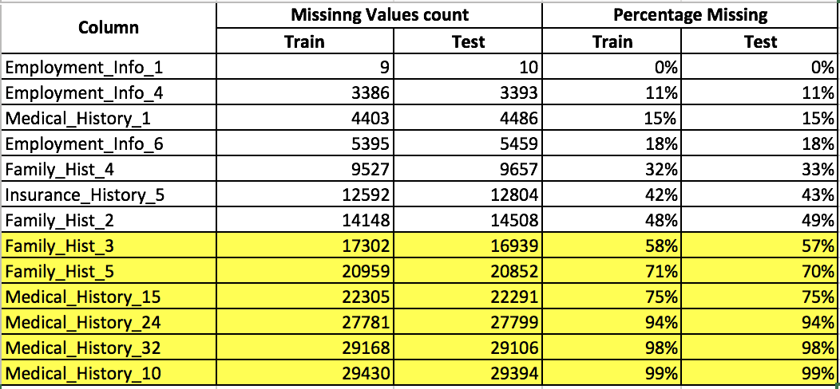
Data Preparation
Missing Values
Variables with missing values - 13
Variables > 60% of missing values were removed
Imputed missing values for the remaining variables

Slide 8
Data Preparation
Imputing Missing Values
Methods used for imputing data:
Replace Missing Values Operator - Rapid Miner
Numeric Values – Average
Categorical Values – Median
Using missForest (R)
5 – iterations
50 – tress in each iteration

Slide 9
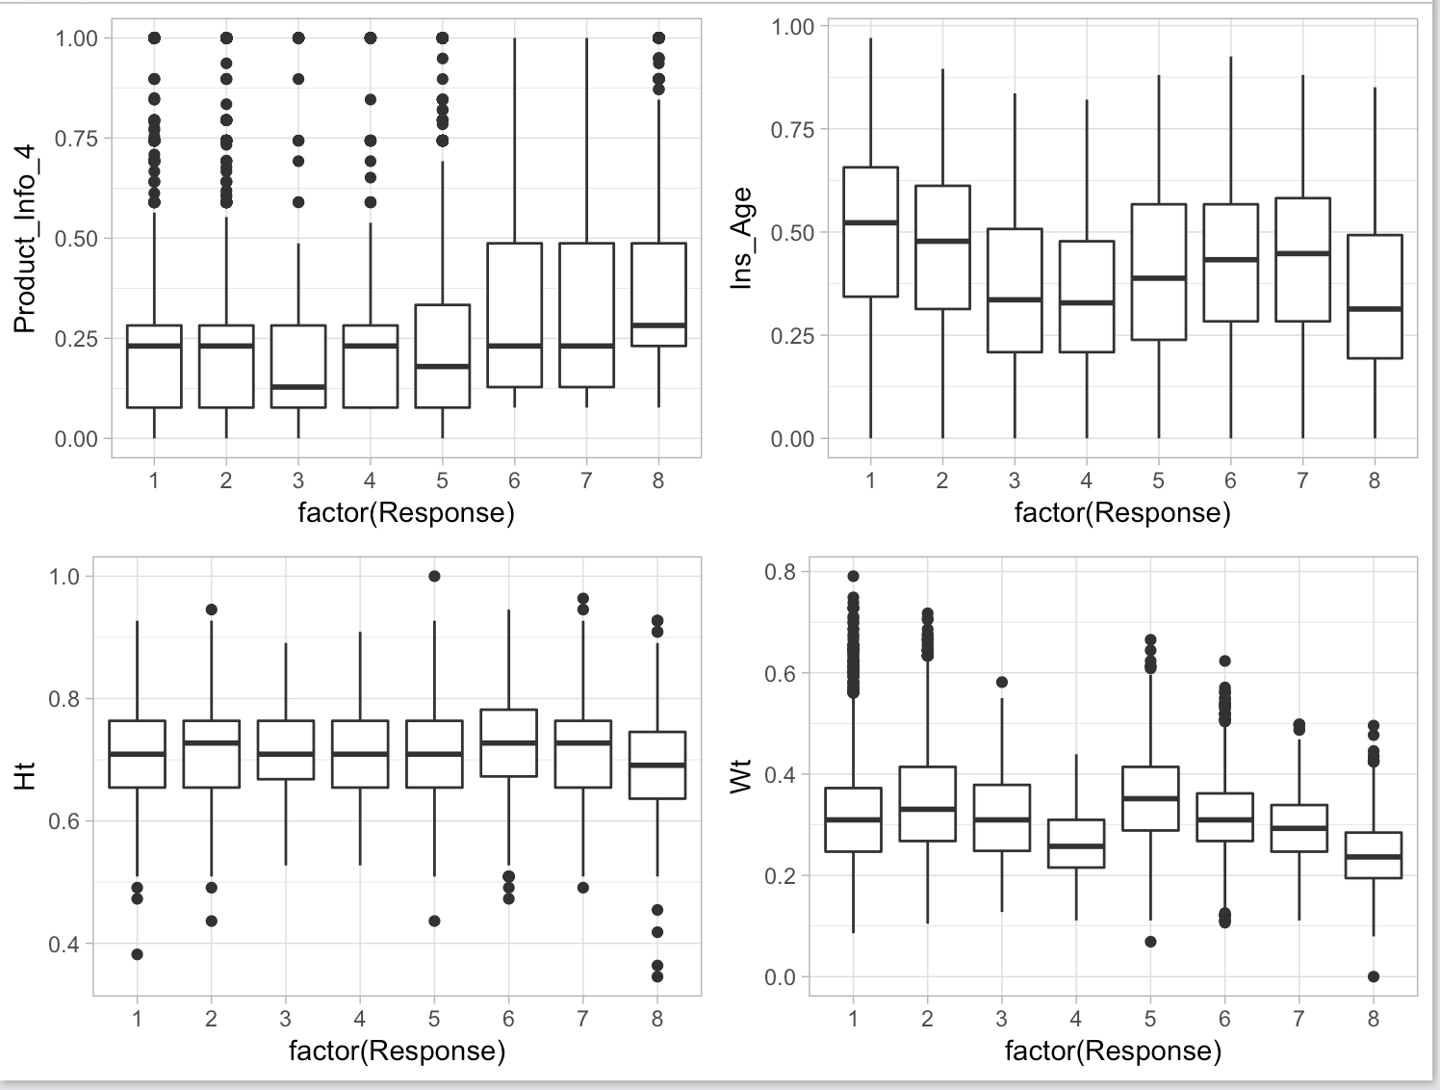
Data Preparation
Outliers
Analyzing Continuous variables using Box Plots

Slide 10
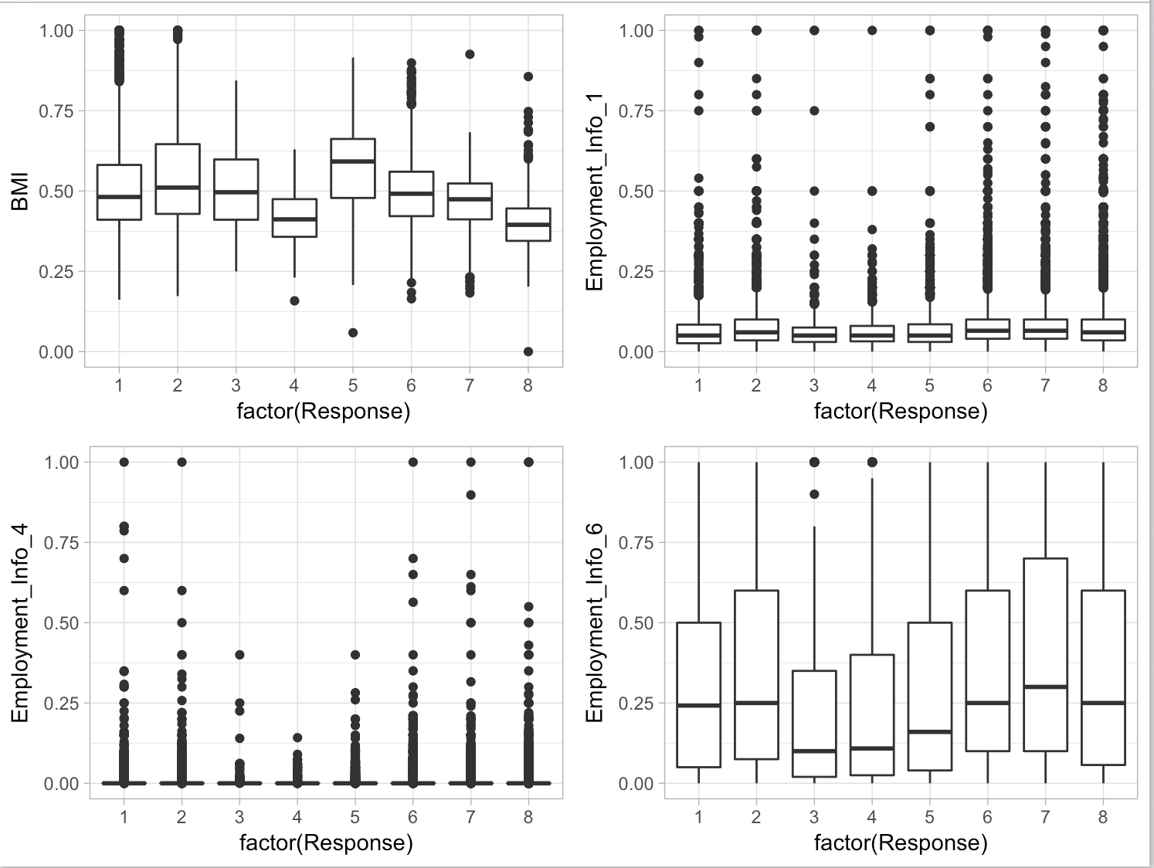
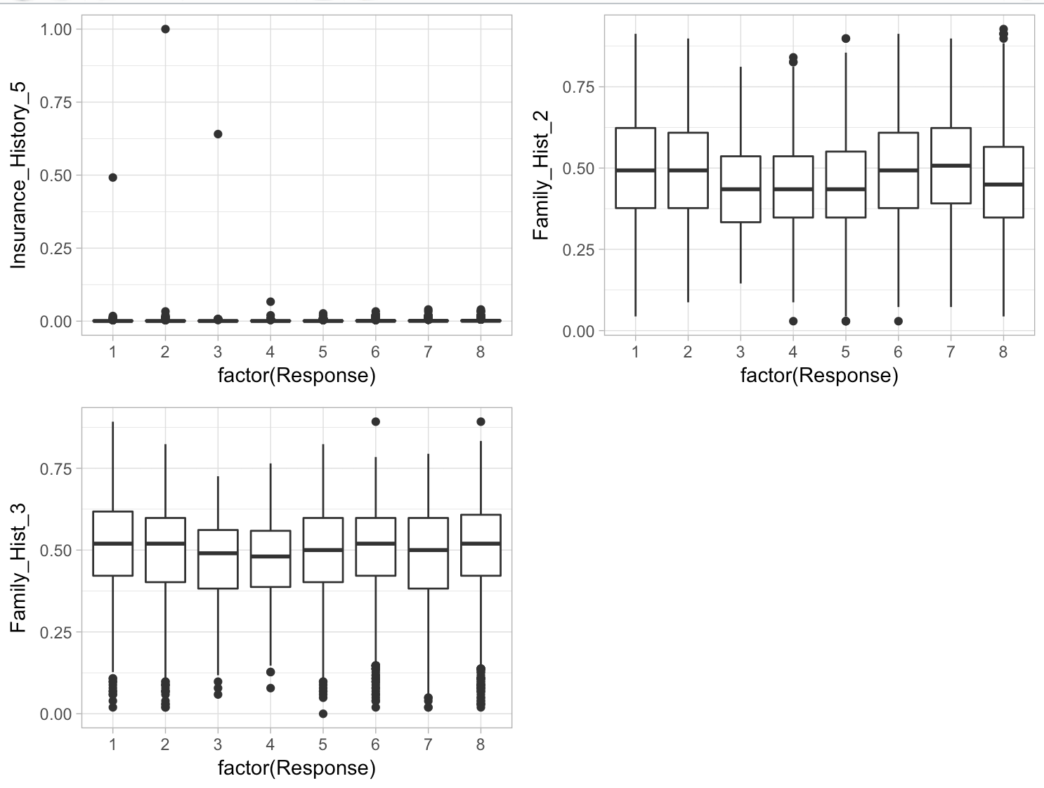
Data Preparation

Slide 11
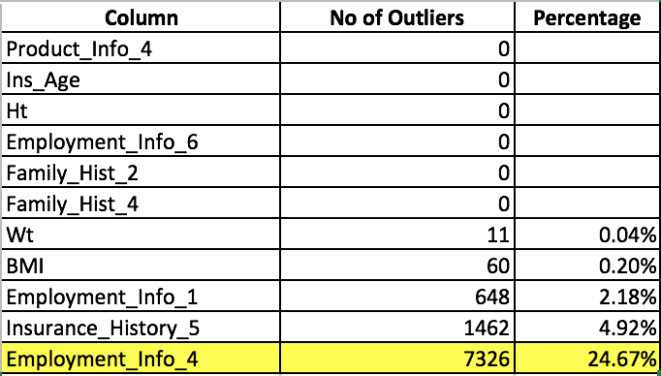
Data Preparation
Summary of Data outside quartile + 3(inter quartile range)
Removed all outliers and replaced them with mean values

Slide 12
Data Preparation
Significant Variables
Intuition
Considered all variables expected InsuredInfo variables
Height, Weight, BMI, InsAge – High Weightage
Employment_History, Insurance_History – Medium Weightage
Remaining – Low Weightage

Slide 13
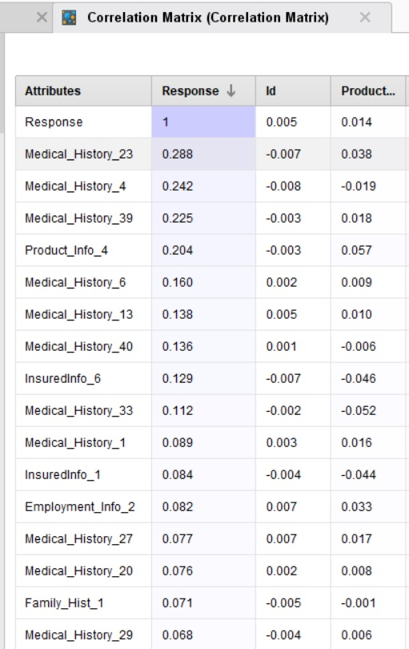
Data Preparation
Correlation Matrix

Slide 14
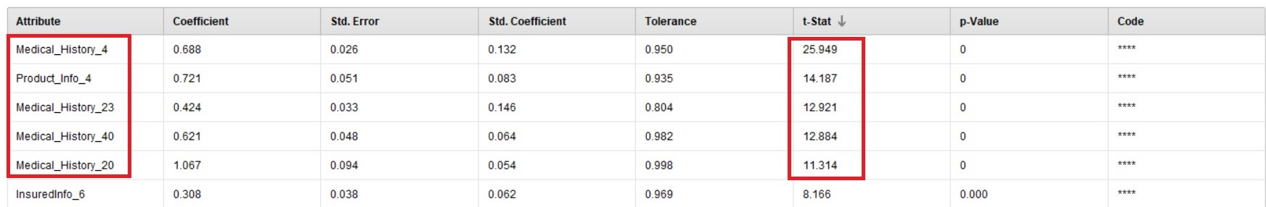
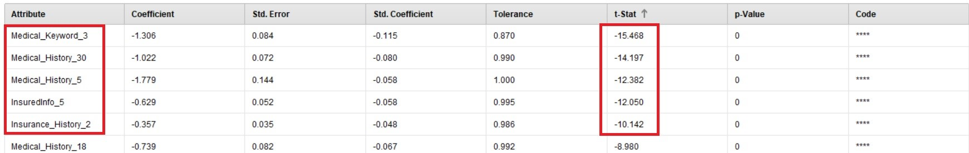
Data Preparation
Linear Regression

Slide 15
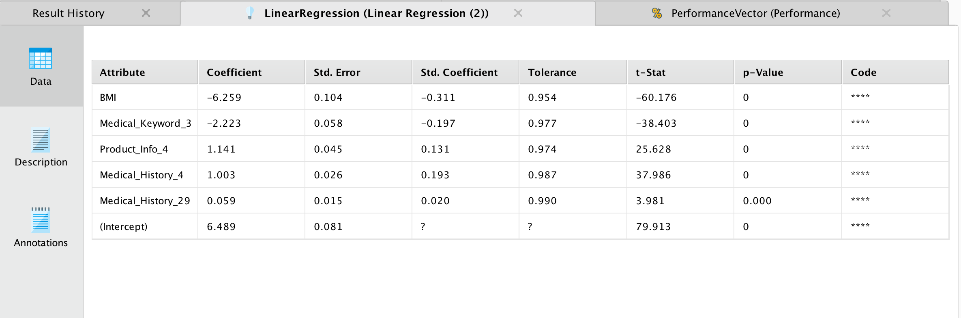
Data Preparation
Forward Selection

Slide 16
Data Preparation
Shortlisting
Medical_History_23 | Medical_History_4
Medical_History_20 | Medical_History_40
Medical_History_30 | Medical_History_13
Medical_History_5 | Medical_History_39
Medical_History_6 | Product_Info_4
InsuredInfo_5 | InsuredInfo_6
Insurance_History_2 | Product_Info_4
Medical_Keyword_3 | BMI
Ins_Age

Slide 17
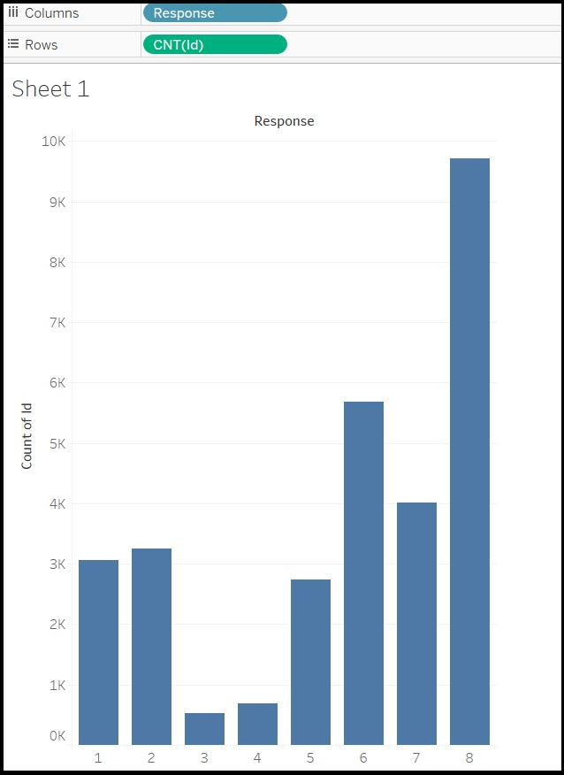
Evaluation Metrics
Base Line
Class that has most number of observations – Class 8
No of records in class 8 – 9711
Total no of records – 29691
Baseline=9711/29691=32.70
Any model that has accuracy more than the
Baseline is a useful model

Slide 18
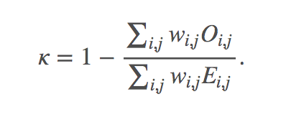
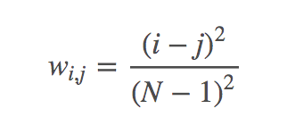
Evaluation Metrics
Weighted Kappa
Predictions are scored based on the quadratic weighted kappa, which measures the agreement between predicted and actual values.
Kappa is calculated using below formula:
Where,
O – Confusion Matrix
E - An N-by-N histogram matrix of expected ratings, assuming that there is no correlation between rating scores.

Slide 19
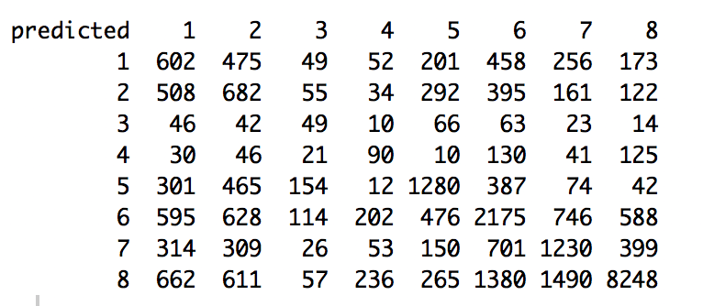


Model
R – C50 Classification Algorithm

Slide 20
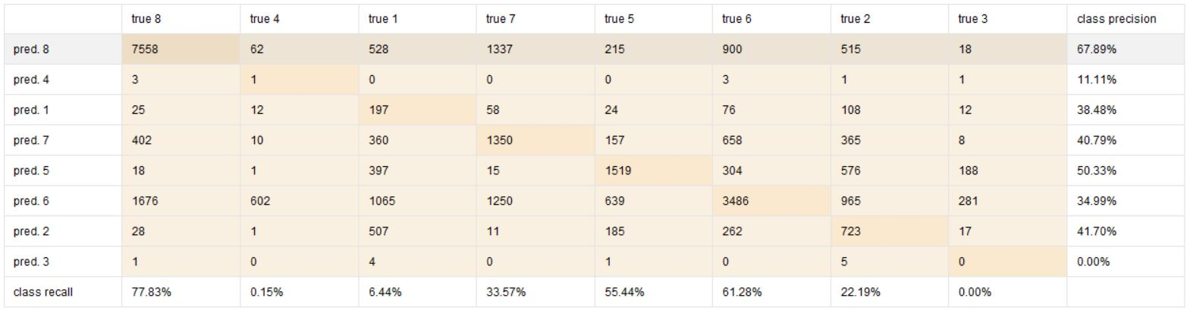
Model
Rapid Miner – Decision Tree
Accuracy – 49.96%
Kappa – 0.359

Slide 21
Model Comparison & Summary
 | Rapid Miner – Decision Tree | R – C50
Accuracy | 49.96% | 48.35%
Quadratic Weighted Kappa | 0.359 | 0.445
Rapid Miner had slightly better accuracy but less weighted kappa. So, its is better to take C50 model than rapid miner`s decision tree model

Slide 22
YouTube Link
Please refer to the below link to access our video presentation.
https://youtu.be/1K1HYilaiuU

Slide 23
Thank you

